Slide 1


Army Technology Acquisition Program Overview
Medical Care Support Equipment
(MEDCASE)
Super Capital Expense Equipment Program (SuperCEEP)
Capital Expense Equipment Program
(CEEP)
Dan Burrhus, MEDCOM, G-4 TAP Manager
SECURITY CLASSIFICATION:
Unclassified

Slide 2
Purpose and Outline
Unclassified//FOUO
Purpose: To Provide an Overview of Medical Equipment Requirements Development and Acquisition Management processes
Outline:
Highlights
Scope
Teamwork
Strategy
Process
Execution
Questions
Unclassified//FOUO

Slide 3
TAP HIGHLIGHTS
Unclassified//FOUO
MISSION: Align technology acquisition programs with Army Medicine Priorities IAW TSLCM principles.
RESPONSIBILITIES: Proponent for and Program Management of the AMEDD Capital Equipment Programs including:
Medical Care support Equipment (MEDCASE)
Super Capital Equipment Expense Program (SCEEP)
Capital Expense Equipment Program (CEEP)
Equipment Standardization
ELIGIBILITY
Generating Force (TDA) Equipment Requirements
Non Expendable
Accountable (Property Book – Hand Receipted)
FUNDING
Defense Health Procurement (DHP) dollars
TAP is executed based on DoD Appropriations authorities
APPROPRIATION | FUND EXPIRATION | THRESHOLDS | TAP Program | MANAGEMENT
Procurement | 3 yr | $250K+ | MEDCASE | Central
Operations & Maintenance | 1 yr | $100K-$250K | SuperCEEP | Central
Operations & Maintenance | 1 yr | $1-$100K | CEEP | Local (Hard Fence)
Medical MILCON | 5 yr | N/A | Varies | Central (HFPA)
Unclassified//FOUO
Notes:
TIGOSC: AMEDD Technology Insertion General Officer Steering Committee OTSG Reg 15-88/MEDCOM Reg 15-11

Slide 4
TAP SCOPE
Unclassified//FOUO
Unclassified//FOUO
Notes:
-Program Value: ~ $3B, 32% of which is sustained by our medical maintenance technicians (Scheduled & Unscheduled Services)
-Program Workload: Represents number of equipment gains in this period, only .87% of which were associated with TAP Centrally Managed programs.
-Executed Funds: Massive 34% of TAP funds are applied to only .87% of the equipment purchased in TAP. Is primary reason we centrally manage them.
-Lifecycle Replacement Volume: Represents what’s in the TAP pipeline. Emphasis on $78M advise replacement and $587M program for replacement in relation to ~ $170M/Yr TAP program = critically important to take excellent care of the equipment we have AND to acquire the right equipment at the right time and at the best price.
-Lifecycle Replacement Workload: % of equipment reaching life expectancies broken by central and local program management. Emphasis on parity with executed funding, which indicates that our funding execution is appropriately aligned with life expectancies. Indication that we are acquiring the right equipment at the right time and at the best price.
-Programed Funding: Shows that MTFs are spending more on local (CEEP) requirements than I am programming for them.

Slide 5
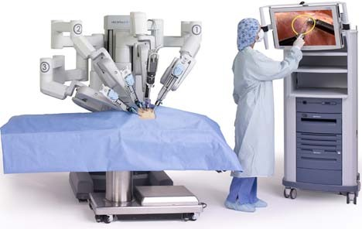
TAP Overview
Unclassified//FOUO
Routine modernization/replacement equipment
May fund MEDCOM-wide central procurements and new initiatives, such as Digital Mammography, Surgical Robotics and Tele-Health Carts
Requirement Approval does not guarantee funding
Unclassified//FOUO

Slide 6
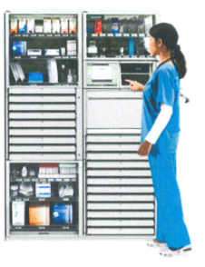
TAP Teamwork
Unclassified//FOUO
Strategic Technology Clinical Policies Council (STCPC) + OTSG Clinical Consultants
Oversee Centrally Managed Programs (MEDCASE/SuperCEEP)
Designates candidates for central procurement, i.e., DIN-PACS
Medical Command (MEDCOM) DOL/G4/TAP
Program Manager / Proponent (policy) SB 8-75-MEDCASE
Budget Development and Defense
United States Army Medical Materiel Agency (USAMMA)
Develop equipment requirements consistent with mission needs (TARA)
Execute Centrally Managed Programs
Regional Health Command (RHC) / Major Subordinate Command (MSC)
Monitor and ensure program execution IAW MEDCOM guidance and Command goals
Military Treatment Facilities (MTF)
Develop equipment requirements consistent with mission needs
Monitor and ensure program execution IAW MEDCOM guidance and Command goals
Unclassified//FOUO
Notes:
TIGOSC: AMEDD Technology Insertion General Officer Steering Committee OTSG Reg 15-88/MEDCOM Reg 15-11

Slide 7
TAP Responsibilities
Unclassified//FOUO
Strategic Technology Clinical Policies Council (STCPC)
Established under MEDCOM Memorandum 15-25 (2003)
TAP Connection to TIGOSC (Reg 15-11)
G3/5/7 Clinical Chairperson w/ Consultant support
Oversees Centrally Managed Programs (MEDCASE/SuperCEEP)
Designates candidates for central procurement, i.e., DIN-PACS, direct digital radiography, and POU
Evaluates/Recommends approval/disapproval of centrally managed program requirements and funding annually (August)
Unclassified//FOUO
Notes:
TIGOSC: AMEDD Technology Insertion General Officer Steering Committee OTSG Reg 15-88/MEDCOM Reg 15-11

Slide 8

TAP Responsibilities
Unclassified//FOUO
OTSG Clinical Consultants
Review and Approve/Disapprove Central Program Requirements
STCPC Panel Members
Consultants Handbook made available to all consultants
6th edition, dated October 2005.
*CHIEF CONSULTANT (STCPC Chair)
MEDICAL CORPS
NURSE CORPS
DENTAL CORPS
MEDICAL SPECIALIST CORPS
MEDICAL SERVICE CORPS
VETERINARY CORPS
Unclassified//FOUO

Slide 9
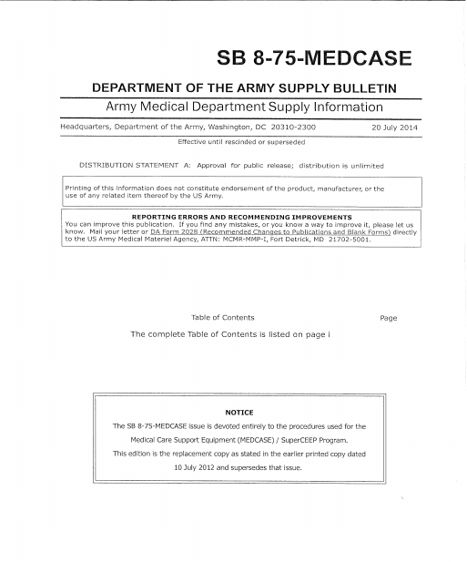
TAP Responsibilities
Unclassified//FOUO
Medical Command (MEDCOM) DOL/G4/TAP
Program Manager
Proponent (policy)
SB 8-75-MEDCASE dated 20 July 2014
Budget Development and Defense
Unclassified//FOUO

Slide 10

TAP Responsibilities
Unclassified//FOUO
United States Army Medical Materiel Agency (USAMMA)
Executes Centrally Managed Programs
Program eligibility & requirements documentation management
Technology Assessment & Requirements Analysis (TARA)
Procurement source coordinator (which contract agency)
Web-based MEDCASE Requirements and Execution (WebMRE) Proponent
Appropriated funds execution
LOCAL PURCHASE via LOAs
US ARMY HEALTH CONTRACTING ACTIVITY (HCA)
REGIONAL HEALCH CONTRACTING OFFICES (RHCO)
Unclassified//FOUO
Notes:
that maintains the database for all MEDCASE and the execution of the program.

Slide 11
TAP Responsibilities
Unclassified//FOUO
Regional Health Command (RHC) / Major Subordinate Command (MSC)
Coordinate all TAP requirement development and execution within their Command
Review and Approve/Disapprove requirements before submission into TAP Centrally Managed Programs
Monitor and ensure program execution IAW MEDCOM guidance and Command goals
SB 8-75-MEDCASE
OPORD 17-29 (TAP Execution)
Unclassified//FOUO

Slide 12
TAP Responsibilities
Unclassified//FOUO
Military Treatment Facilities (MTF)
Develop equipment requirements consistent with mission needs
Commander reviews and Approves/Disapproves requirements; ensuring the information provided is complete and accurate
Monitor and ensure program execution IAW MEDCOM guidance and Command goals
SB 8-75-MEDCASE
OPORD 17-29 (TAP Execution)
Unclassified//FOUO

Slide 13
TAP Acquisition Strategy (Central)
Unclassified//FOUO
Requirement Prioritization / Program Approvals
AUG/SEPT
SEPT
STCPC Chairman
Briefs Minutes
and Priority List to
MEDCOM Leadership
MEDCOM notifies MTFs of Approved/Funded requirements via TAP Execution OPORD
(8 Phases)
AUG
OCT
Technology
Acquisition
Strategy
MEDCOM
Releases Funds
STCPC, MEDCOM, and
USAMMA Meet to
Prioritize Requirements
JUL
OCT - JUL
MEDCOM Monitors
Obligations and Program Execution & Develops CEEP Lifecycle Program Funding
TARA Site Visits
TARA Validates Equip. Quotes
TARA Generates Requirements
MTFs Generate Requirements
& Locally Executes CEEP
MTFs
Validate Expiring
Requirements and Submit
New Requirements for
Consideration during STCPC
USAMMA and MEDCOM
Finalizes Information for STCPC
USAMMA Issues LOAs
for Procurement
JUN
USAMMA Requisitions Requirements thru DLA-TS
Work Urgent Requirements
Requirement Identification / Approved Requirement Acquisition
Unclassified//FOUO

Slide 14
OPORD 17-29 (TAP E) Due-Outs
RHC
Beginning 20 February & by 20th / month: TAP Execution Progress Reporting
1 Apr 17: Solicit additional CEEP funds if necessary (internally)
20th of April, August and October 2017: Report FRP to STCPC
5 May 17: Submit SuperCEEP/MEDCASE for FY18 STCPC
22 Jun 17: Submit prioritized FY18 STCPC requirements
30 Sept 17: Acquire CEEP to Hard Fence
Notes:
Gary Tacket 28 Sept 16: I need to request a FAD be approved to transfer FY15/17 Procurement Funding, from our IM/IT Set Aside, to the Essentris PMO, within DHA, to support the remaining FY16 Certification for Essentris requirements for the remaining Army Sites, identified within the attached quotes.
Walter Ruggles DHA – Please FAD in FY17

Slide 15
OPORD 17-29 (TAP E) Due-Outs
G4/TAP
25 Jan 17: Publish TAP Execution Progress Reporting Mechanism
20 Feb 16: Receive & analyze 1st TAP Execution Progress Report & build summary into TAP Program Status & LPR & CMR
1 May 17: Start FY18 STCPC Prioritization Schedule
14 May 17: FY18 STCPC Kick-Off Planning Meeting (on calendar)
2 Jun 17: Provide MTFs unfunded SuperCEEP/MEDCASE list for their prioritization for input into FY18 STCPC.
Coordinate Technology Acquisition Program Execution training.
Coordinate with the G6 to integrate Risk Management Framework into Technology Acquisition Program processes.
Coordinate development of TAP capability via G4 IMPACT #64.
Participate in quarterly STCPC IPRs (April, August and October of CY2017).
Integrate Medical Materiel Enterprise Standardization outcomes into Army Technology Acquisition Programming.
Set-Aside Projects
Optical Fabrication – SFC Perez $9.1M
Secure Enterprise Dictation – COL Oliver $6M
Surgical Robotics – COL Harnisch $8.509M
Notes:
Gary Tacket 28 Sept 16: I need to request a FAD be approved to transfer FY15/17 Procurement Funding, from our IM/IT Set Aside, to the Essentris PMO, within DHA, to support the remaining FY16 Certification for Essentris requirements for the remaining Army Sites, identified within the attached quotes.
Walter Ruggles DHA – Please FAD in FY17

Slide 16
OPORD 17-29 (TAP E) Due-Outs
STCPC
26 Apr 17: Host quarterly STCPC IPRs
28 Aug – 1 Sept: Host the FY18 STCPC
30 Aug 17: Host quarterly STCPC IPRs (during STCPC)
25 Oct 17: Host quarterly STCPC IPRs
Provide technology consultation in support of Technology Acquisition Program Execution.
Provide technical consultation in support of New Technology Requirement Identification.
Execute FY17 STCPC Due-Outs IAW Paragraph 16 of the FY17 STCPC Minutes as follows:
Establish the following STCPC Subcommittees: Surgical Robot Subcommittee, Clinical Technology Subcommittee (CTS).
Redefine CT siting criteria.
Reengineer Hybrid OR Working Group prior to fielding additional Hybrid ORs.
Support Army as Executive Agent of the DHA Joint Requirement Analysis (JRA) initiative.
Report on effectiveness of:
Breast Tomosythesis Integration with PACS at MAMC
Radiation Dose Monitoring Capability
Softex Illuminate Software at SAMMC
Redefining CT Minimum Standards below current 64 slice standard
Redefining MRI Minimum Standards from 3T to 1.5T for first or only MRI
Establishing Neuroquant software volumetric analysis the Minimum Standard for TBI Patients
Notes:
Gary Tacket 28 Sept 16: I need to request a FAD be approved to transfer FY15/17 Procurement Funding, from our IM/IT Set Aside, to the Essentris PMO, within DHA, to support the remaining FY16 Certification for Essentris requirements for the remaining Army Sites, identified within the attached quotes.
Walter Ruggles DHA – Please FAD in FY17

Slide 17

TAP Process (Central)
Unclassified//FOUO
TARA Team
Generates
Requirements
MTF
Generates
Requirements
SuperCEEP
MEDCASE
Concurred
Concurred
(1A)
(1A)
COS
Non-concurred
As Required
Non-concurred
Requirement Deleted
TSG
Requirement Deleted
G4 TAP
releases funds for
procurement
of requirements
Unclassified//FOUO

Slide 18

TAP Process (Local)
Unclassified//FOUO
CEEP
MTF
Generates
Requirements
Concurred
Non-concurred
PBAC
(1A)
Local Staffing
Requirement Deleted
and Review of
Requirements
MTF Commander
Local RM Releases
Funds
Unclassified//FOUO

Slide 19
TAP Overview - Measures
3) Identify Performance Metrics/KPIs utilized throughout the Requirements Planning and Acquisition Management process
Requirements Planning Efficiency
Are we documenting the correct requirements?
Are we controlling Make/Model Variance?
Requirements Funding Efficiency
Do we have enough funds to accommodate our requirements?
Are we efficiently obligating the funds we have?
Are we funding the right requirements?
Requirements Acquisition Efficiency
Are we executing our acquisitions efficiently?
Are we efficiently On-Boarding what we acquire?
Risk Management Framework
Is RMF synchronized with Acquisition?
Are we programming enough funds for RMF?
Are we monitoring risk?
Sustainment
Are we delivering efficient, cost effective sustainment?
Are costs controlled?
MEASUREMENT CHALLENGES
Low (no) Authorizations (TDA)
Multiple Data Sources
No Enterprise Capability
Low Data Quality
No TLCSM Accountability
Notes:
Low TLCM Process/Systems Integration
Plan – TARA <1% RMF = 0
Fund – Largely unrelated to Planning
Acquisition – Asynchronous
LCSP – Non Existent (PACS on)

Slide 20
TAP Overview - Measures
3) Identify Performance Metrics/KPIs utilized throughout the Requirements Planning and Acquisition Management process
Requirements Planning Efficiency
Programming
Required vs Authorized Rate (Want vs Need vs Have)
TARA Program Efficiency?
Make/Model Variance
Utilization
Excess Reutilization Rate
Replacement Advised Requirement Rate
Growth
New Technology Requirement Rate
Requirements Funding Efficiency
Programming
Program Status of Funds (SOF)
Lifecycle Requirement Funding Rate
New Requirement Funding Rate
Utilization
Obligation Rates
Spend Plan Efficiency Rates
% applied to “Replacement Advised”
Requirements Acquisition Efficiency
Execution Rates (Phases)
First Pass Rates
Risk Management Framework
RMF Synch Rate / Use Delay Rate
Reciprocity Rate
RMF Program Funding Rate
RMF Cost Controls
RMF Monitoring Rates
Sustainment
Reliability
Availability
Maintainability
Cost Controls

Slide 21
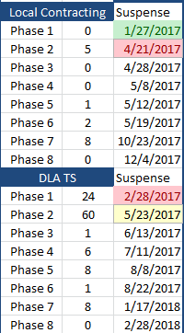
TAP Execution (Central – MEDCASE)
3) Identify Performance Metrics/KPIs utilized throughout the Requirements Planning and Acquisition Management process
Mission: Status of Funds
As of 13 Apr 17
Phase I: Document Minimum Essential Characteristics (MEC)
Phase II: Conduct Market Research
Phase III: Document Product Selection Decision
Phase IV: Develop Requisition Packet
Phase V: QA/QC & Approval of Requisition Packet (MTF/RHC)
Phase VI: Apply Funds
Phase VII: Contracting
Phase VIII: New Equipment Onboarding
Acquisition Team Lead
LOG

Slide 22
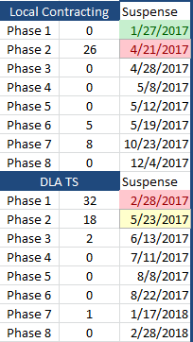
TAP Execution (Central – SuperCEEP)
3) Identify Performance Metrics/KPIs utilized throughout the Requirements Planning and Acquisition Management process
Mission: Status of Funds
As of 13 Apr 17
Phase I: Document Minimum Essential Characteristics (MEC)
Phase II: Conduct Market Research
Phase III: Document Product Selection Decision
Phase IV: Develop Requisition Packet
Phase V: QA/QC & Approval of Requisition Packet (MTF/RHC)
Phase VI: Apply Funds
Phase VII: Contracting
Phase VIII: New Equipment Onboarding

Slide 23
TAP Execution (Local - CEEP)
3) Identify Performance Metrics/KPIs utilized throughout the Requirements Planning and Acquisition Management process
CEEP AUGUST
FY18 CEEP | CERP UTILIZATION RATE |  |  | EXECUTION RATE | FUNDING DELTA
 | (EXECUTED REQUIREMENTS)
STANDARD | % Rating Scale is NOTIONAL |  |  | 8% by 31 Oct | Hard Fence Balance (minus) CERP Unexecuted Requirements
 | RED (0-50 or 151+)% |  |  | 75% by 31 Mar
 | BLUE (51-75)% GREEN (76-125)% |  |  | 100% by 31 Jun
 | CERP | GFEBS | % DIFF | JULY | FUNDS AVAIL.
RHC-A | $ 23,814,190 | $ 45,760,200 | 52% | 218.6% | $ (50,254,962.75)
RHC-C | $ 17,450,929 | $ 30,811,600 | 57% | 119.5% | $ (42,355,934)
RHC-E | $ 453,340 | $ 11,359,600 | 4% | 206.7% | $ (8,481,862)
RHC-P | $ 19,061,986 | $ 20,964,200 | 91% | 123.6% | $ (35,615,050)
AMEDDC&S | $ 300,982 | $ 3,797,500 | 8% | 415% | $ (3,813,667)
TOTAL | $ 61,081,427 | $ 112,693,100 | 54% | 160.8% | $ (140,521,475)
*Indicates no requirements documented in CERP
Red Font indicates under performance or negative trend.
Green Font indicates above standard performance or positive trend.

Slide 24
Technology Assessment & Requirements Analysis (TARA)
Unclassified//FOUO
TARA is a management tool that provides unbiased review of clinical requirements and operations for medical treatment facilities.
Assist MTF Commanders with management information necessary to make informed decisions on the clinical and technological resources required to accomplish business plan missions.
Recommends replacement of equipment/technology and provides capital asset management through the MEDCASE program.
Focus is assistance NOT inspection.
Regionally based.
Addresses standards of care.
Areas reviewed are radiology, nuclear medicine, general surgery, internal medicine, laboratory, nursing, and pharmacy.
WHY TARA?
Unclassified//FOUO

Slide 25
TARA Modalities
Unclassified//FOUO
Angiography
C-Arms (mobile)
Cardiac Cath Labs
Computerized Tomography (CT)
Radiographic
Computed Radiology (CR)
Diagnostic Rad & Rad/Fluoro
Direct Digital Radiology
Gamma Cameras (Nuc Med)
Interventional Radiology
Linear accelerators
Magnetic Resonance Imaging (MRI)
Mammography
Ultrasound
Cart Washers
Clinical Information Systems
Endoscopes/Video Towers
Monitoring systems
Physiological Monitoring
Fetal Monitoring Systems
Nurse Call Systems
Point of Use (POU) Systems
Robotic Pharmacy Systems
Sterilizers
Surgical Lasers
Surgical Microscopes
Unclassified//FOUO

Slide 26
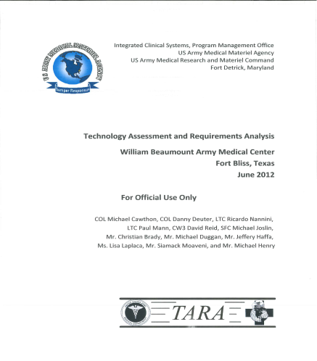
TARA Site Visit Process
Unclassified//FOUO
List all equipment assessed in visit (˃$100,000)
SuperCEEP
MEDCASE
Recommend for upgrade/replacement.
Develop 5-year MEDCASE/SuperCEEP plan.
Development asset control number and enters in WebMRE.
Estimate cost replacement/upgrade/new.
Unclassified//FOUO

Slide 27
TARA Tools
Unclassified//FOUO
TARA Group and Volume Buys:
Group: Performs Full and Open Competition and convenes a source selection board (SSB) to select a single vendor.
Volume: Assists sites by requesting a "Volume" discount for a product/vendor chosen by multiple sites.
Access to MEDCOM Consultants and the STCPC for decisions on way forward with technology.
Promotes standardization efforts!
Unclassified//FOUO

Slide 28
FY 2017 TARA Schedule
FY17
Site | Type | Region | Forecasted
STCPC | Meeting |  | 24-28 Oct 2016
Fort Bragg | MEDCEN | RHC-A | 31 Oct - 9 Nov 2016
RSNA | Meeting | Industry & Academia | 27 Nov - 2 Dec 2016
Fort Lee | MEDDAC | RHC-A | 12-13 Dec 2016
Fort Eustis | MEDDAC | RHC-A | 14-16 Dec 2016
TAMC | MEDCEN | RHC-P | 9-20 Jan 2017
Landstuhl/ERMC Clinics | MEDCEN | RHC-E | 6-31 Mar 2017
Fort Polk | MEDDAC | RHC-C | 8-12 May 2017
Fort Stewart | MEDDAC | RHC-A | 12-16 Jun 2017
STCPC | Meeting |  | August 2017
TARA visits are performed on an iterative cycle
7 to 10 sites per FY
MEDCENs: 3 years
Community Hospitals: 4-5 years
Proposed FY18
Site | Type | Region | Forecasted
Fort Benning / Redstone Arsenal | MEDDAC | RHC-A | Oct-17
Fort Leonard Wood | MEDDAC | RHC-C | Nov-17
RSNA | Meeting | Industry & Academia | Nov-17
Joint Base Lewis McChord | MEDCEN | RHC-P | Jan-18 (2 weeks)
West Point / Fort Drum | MEDDAC | RHC-A | Mar-18
Fort Huachuca/ Fort Leavenworth | MEDDAC | RHC-C | Jun-18
STCPC | Meeting |  | Aug-18
Notes:
Under revision

Slide 29

MEDCASE Overview
Unclassified//FOUO
Management: Central
Level: Department of the Army
Funding: DHP Procurement
3-year appropriation
$250+ unit/system price
Eligibility criteria: SB 8-75-MEDCASE
Purpose:
Capital investment equipment acquisition for fixed (TDA) AMEDD activities worldwide
Also supports approval and acquisition of MILCON funded investment equipment for major medical construction projects
Unclassified//FOUO

Slide 30
MEDCASE Program Eligibility
Unclassified//FOUO
Must be classified as capital investment type equipment with a unit/system price $250K+
Required to accomplish or support a health care mission at a fixed (TDA) activity
Not centrally managed or funded through another DA-level program
Major end-item or system
Not required to provide back-up to existing equipment
Unclassified//FOUO

Slide 31


Requirement Development
Unclassified//FOUO
There are two ways a requirement can be developed:
Site (MTF) generated
Technology Assessment Requirements Analysis (TARA) generated.
TARA
Unclassified//FOUO

Slide 32
Requirement Development – Site Generated
Unclassified//FOUO
Requestor forecasts replacement, modernization or new mission requirements
Requestor initiates DA Form 5027/5028 and modified purchase analysis
Justification is a user (clinical) responsibility
Should state the minimum essential characteristics of the item and provide a clinical or functional need (mission)
Must be supported by facts, not general statements to workload increase, etc
Must relate the capabilities requested to the actual requirements of the activity – not what the equipment does but what it can do for you
Urgent requirements require additional justification and approvals.
The requestor assembles and submits the complete packet with all attachments and supporting documentation through applicable channels
Unclassified//FOUO
Notes:
Modernization includes: advancements in technology or standards of medical practice. Lead for this activity is STCPC Scientific Officer.

Slide 33
Justification of Requirements
Unclassified//FOUO
Must include responses to 7 questions:
Equipment use and why needed.
Interoperability.
What are the advantages of the requested item over equipment currently in use or available on the market? Why are these advantages needed?
Have specific details been presented regarding cost-benefit, personnel savings, or productivity, the enhancement or curtailment of services, frequency or duration of breakdown, or other specific factors that may be relevant?
What will be the impact upon mission accomplishment if the requested item is not acquired?
Anticipated workload.
Has consideration been given to the use of available excess assets to satisfy this requirement?
Unclassified//FOUO

Slide 34
Approval Process – Site Generated
Unclassified//FOUO
MTF submits locally approved MEDCASE to RHC/MSC.
Activity should submit as the commander approves them. They are not to be held at the activity and submitted in batches. Routine requirements are submitted during the budget year – during FY17 submission should be for FY18 and beyond.
RHC/MSC Commander reviews and Approves/Disapproves. Approved requirements are forwarded to USAMMA.
USAMMA reviews for administrative errors and eligibility. USAMMA forwards to TSG consultant for review and Approval/Disapproval.
Approval is based upon priority of need, and not related to the present or the anticipated availability of funding.
Unclassified//FOUO

Slide 35

Approval Process – Site Generated
Unclassified//FOUO
STCPC convenes in August to review and prioritize for funding all MEDCASE submissions.
STCPC Chairperson coordinates MEDCOM leadership review/approval.
MEDCOM G4 coordinates acquisition activities for all approved requirements up to available funding
Unclassified//FOUO

Slide 36
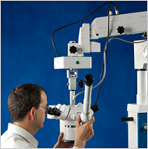
SuperCEEP Overview
Unclassified//FOUO
Management: Central
Level: Army Medical Department
Funding: DHP O&M
1-year
$100K-$250K (EOR 31xx)
Eligibility criteria: SB 8-75-MEDCASE
Purpose:
Capital investment equipment acquisition for fixed (TDA) AMEDD activities worldwide
Eligibility, Development, Justification & Approval mirror MEDCASE.
Unclassified//FOUO
Notes:
Management: Central
Level: Department of the Army
Funding: DHP Procurement
3-year appropriation
$250+ unit/system price
Eligibility criteria: SB 8-75-MEDCASE
Purpose:
Capital investment equipment acquisition for fixed (TDA) AMEDD activities worldwide
Also supports approval and acquisition of MILCON funded investment equipment for major medical construction projects

Slide 37
SuperCEEP Overview
Unclassified//FOUO
Urgent or unfunded SuperCEEP requirements may be locally funded if central funding is not available.
Activities will seek MEDCOM approval to locally fund SuperCEEP items.
Locally funded SuperCEEP requirements will have established, staffed and approved SuperCEEP packets and will be entered into the web MRE.
Locally funded SuperCEEP requirements are not eligible for central site-prep funding.
Unclassified//FOUO

Slide 38
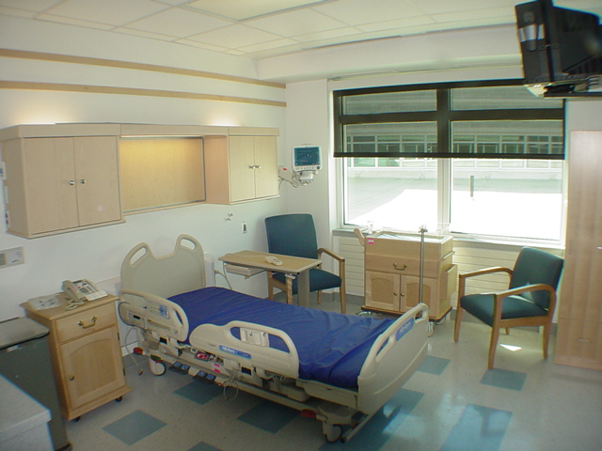
CEEP Overview
Unclassified//FOUO
CEEP is non-expendable and durable equipment items that are under $100K each utilizing DHP OM funds for fixed facilities.
MEDCOM has developed guidance for the local CEEP program. Guidance is published in SB 8-75-11, chapter 5.
G-4 and G-8 established a ‘Hard-Fence’ target for each MTF.
Uses 3-year average of equipment that has
met life expectancy (current and two out years).
Developed from JMAR.
FY17 ‘Hard-Fence’ is IN ADDDITION TO core budget.
Unclassified//FOUO

Slide 39
CEEP Overview
Centralized Equipment Program Requirements (CERP)
The requestor initiates CEEP request in the automated CERP application.
MEDCOM G-4 is the proponent for the web-based Centralized Equipment Program Requirements (CERP) SharePoint application.
SharePoint “wizard” builds comprehensive Capital Expense Equipment Program (CEEP) packets and automates the routing and approval workflow process.
Accessible through Army Medicine Portal.
Provides enterprise visibility of requirements and data.
CEEP approval authority remains with RHC and MTF per SB 8-75-MEDCASE
OPORD 16-14, Centralized Equipment Program Requirements Program (CERP)
Unclassified//FOUO

Slide 40
CEEP Overview
Unclassified//FOUO
Prioritization and Reporting IAW SB 8-75-11:
Develop an end-to-end prioritized CEEP list.
Prioritize through PBAC or other local committee.
Report execution against ‘Hard-Fence’ and prioritized requirement list quarterly to MEDCOM (included in MEDCOM quarterly Command Management Review).
Through the MEDCOM standardization effort, approved unfunded requirements on the PBAC list will be analyzed on a regional and MEDCOM level for potential grouping to leverage better pricing and increase standardization.
Items must be input into DMLSS and a due-in established.
Unused ‘Hard-Fenced” dollars will be swept by Fiscal Year End.
Unclassified//FOUO

Slide 41
CEEP Overview
Unclassified//FOUO
Services performed in connection with the initial installation of equipment are also EOR 31** the same as MEDCASE.
A separate CLIN, line item or contract shall not be written for installation and charged to a different EOR.
Only Property Management is authorized to purchase equipment to include CEEP, furniture, and furnishings.
MEDCOM established CEEP floor is $200 – if it is personal property of a durable nature, period of service of 1-year or more it is CEEP.
Replacement item must be turned in prior to receipt of new item.
Unclassified//FOUO

Slide 42
TAP Process Improvement
Strengths
TAP Campaign Plan
Knowledgeable TAP Staff
Cross Organizational Synergy
STCPC + DIRS
DLA-TS IDIQ Contracts
Weaknesses
No “AMEDD Investment Strategy”
Complex TAP Acquisition Strategy
Not Defense Acquisition System (DAS) Modeled
No IPPD Shared Service Structure
Lacks TLCSM structure/resources/responsibility
Low Process Category Integration (ID/Fund/Acq)
No Enterprise Capability
Inactive STCPC
Low Data Quality
Low Standardization
Opportunities
MEDLOG 2025 – CERP (IMPACT Issue #64)
CERP (SharePoint Capability)
DML-ES (Enterprise Equipment Capability)
TLCM Integration Synergy (G4M + G4TAP + ICS)
DHA Collaboration (SPI, JRA)
CEEP Hard Fence
DHA-BCA
Threats
Cybersecurity (RMF)
Lack of Requirements for MHS-GENESIS
Loss of WebMRE Capability
DLA-TS RFO Requirement Changes
AAA Audit
Notes:
Program Management Challenges
Ambiguous “AMEDD Investment Strategy”
No clear alignment with Army Medicine Priorities
AMCP IP10 / MEDLOG 2025
Readiness – Manning / Training / Equipping / Leader Development
Low Data Quality
Zero Equipment Data Quality Initiatives or Measures
Resides (and overlaps) across multiple systems
Programmatic analytics unavailable
Low Obligation Rates – No Link to Causes
Program Management Opportunities
Leverage MEDCOM DSM to document/improve ETM3 processes
Leverage MEDCOM ATD to establish ETM3 Project
Resource dependent (CSWG/RAMP)
Leverage DHA-HTM to implement a TAP Standardization Program

Slide 43
TAP Process Improvement
PROCESS | IMPROVEMENT | RESULT
Complex TAP Acquisition Strategy | Develop/Implement TAP Campaign Plan (next slide) | Current State Process Mapping Measurement Development/Assessment Opportunity Identification/Implementation TAP Enterprise Capability Documentation Future State – See DOTMLPF-P & Doctrine
 | Improve Process Category Integration | Synchronize Requirements Planning, Funding and Acquisition timelines Increase execution timeline 3-4 months Reduce funding loss risk
 | Operationalized Acquisition Strategy | OPORD 17-29 (TAP Execution) Synchronize Stakeholder Activities Traceable Suspenses (Measures) Risk Management (FRP)
 | Synchronized RFO Processes | FRAGO 1 to OPORD 17-29 (TAP Execution)
 | Integrate RMF into RFO Process | FRAGO 2 Pending
 | Establish RMF as a Product Selection Criteria | FRAGO 3 Pending
MHS-GENESIS | Seek FY18 STCPC support for Wave 2 Programing | STCPC disapproved funding recommendation
 | Programmed / Executed MAMC IOC requirements | $11.2M reprogrammed Averted loss of $8.5M in O&M (FY16)
 | Establish Army MHS-GENESIS MDI PMO | In coordination with MEDCOM G6 CMIO & Capability Manager
Notes:
FRP = Funding Risk Profile
Functional Requirements Document
Functional Requirements Baseline
Capability Analysis Matrix
DOTMLPF-P
DHA-HIT Submission #735

Slide 44









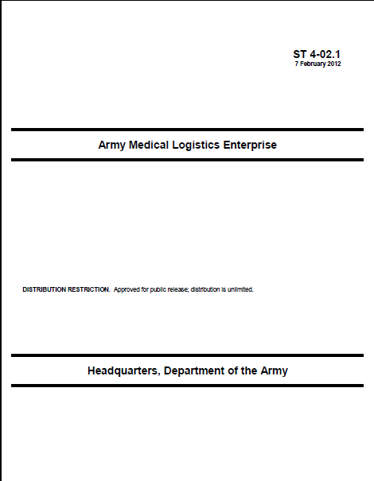





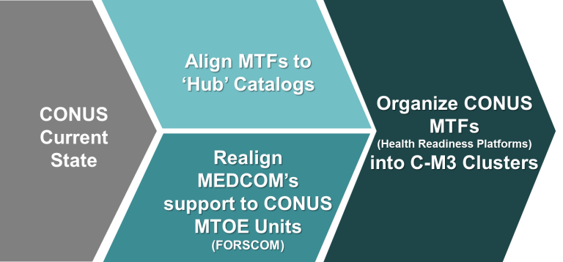


TAP Process Improvement
Lessons Learned
Army & Joint Concepts
Army Medicine Campaign Plan
Business Case Analysis (BCA)
Doctrine
AMLE Implementation
Planning & Priorities
MEDLOG Seminar (AMEDDC&S) 19-23 Apr 10
Sep 14 – Apr 15
MEDCOM Leadership Briefing and Guidance
AMLE CONOPS (ST 4-02.1, 7 Feb 12
DP
-DSM-
-ATD-
Apr 15 – Jul 15
TAP Business Process Mapping (LSS)
Operational Relationships
Staffing
IT
Roles
Project Team Team
STRATCOM
Business Process Reengineering (BPR)
G4/6
TAP Capability Requirement Documentation & Delivery Strategy ($)
Pilots
G6/CIO
OMB & AR 40-61 &
SB 8-75-11 & MEDCASE
Updates
TAP Capability Project/Initiative
(Interim Capability)
WebMRE RISK
G4/TAP
Policies
~ TTP
OPORD
~
EXORD
Other Capability Requirement Documentation
(DML-ES)
MEDCOM RHC
JMLFDC
Decision Point
Notes:
DSM: ADCS Strategy Management
ATD: AMEDD Transformation Directorate
14-03: Standardization of Process for Pt Safety & Quality Management
PMSC: Program Management Support Committee

Slide 45
TAP Process Improvement
Lessons Learned
Army & Joint Concepts
Army Medicine Campaign Plan
Doctrine
AMLE Implementation DOL
8 AUG 16
Planning & Priorities
MEDLOG Seminar (AMEDDC&S) 19-23 Apr 10
AMLE CONOPS (ST 4-02.1, 7 Feb 12
MEDCOM G6 Investment & Requirements Analysis
RESOURCE?
TAP CP INV MGT & DECISION (DML-ES 7-10 YRS)
MDD
BCA
CDD
SUST
Requirements Analysis/Validation
To Be
AoA
ROM
$$
ICDT
FRD
DOTMLPF-P
WebMRE INV MGT & DECISION (COTS/GOTS 6-18MO)
DHA
Decision Point
Notes:
ICD: Initial Capability Document – G6 Governance uses FRD: Functional Requirement Document in lieu of ICD
I-RA: Investments & Requirement Analysis
DSM: ADCS Strategy Management
ATD: AMEDD Transformation Directorate
14-03: Standardization of Process for Pt Safety & Quality Management
PMSC: Program Management Support Committee

Slide 46
TAP Process Improvement
BLUF: Army Requirement to cover numerous Technology Acquisition Program (TAP) capability gaps; requesting review to determine if this is an Army specific or if tri-service requirement gap.
To Be TAP Capability: Defense Acquisition System (DAS) IPPD/PM based enterprise capability that synchronizes/automates DHA Technology Acquisition Programming (TAP) from Requirement Identification to Funding to Acquisition to include integration of Risk Management Framework (RMF) certification processes. Include Lifecycle Sustainment Planning and Execution in order to successfully integrate TAP into a Total Lifecycle Systems Management (TLCSM) framework with Property Accounting, Medical Maintenance, Contracting and Supplies. (See FRD & CAMs)
As Is TAP Capability: TAP process data spread across four systems (WebMRE, CERP, DMLSS, GFEBS). Manual intervention necessary to approximate an enterprise capability. No TLCM capability exists which hinders our ability to affect utilization studies for effective enterprise level programming, including inability to effectively program for and manage Sustainment operations. (See SWOT & USAAA Finding)
Current WebMRE Capability: Requirement ID for equipment with an acquisition cost over $100K. No interoperability (with anything) No collaboration capability
Current CERP Capability: Requirement Identification for equipment with an acquisition cost under $100K. No interoperability with anything. Collaboration capability based (SharePoint).
Current DMLSS Capability: Army does not use for TAP due to onerous TAP capability gaps. Programmed DML-ES capability does not accommodate documented TAP capability gaps.
Notes:
(U) AUDIT OF MEDICAL DEVICE LIFE CYCLE REPLACEMENT (MDLCR) (A-2016-MTM-0169.000) (U) (DASG-LOZ) On 19 January 2017, the AAA Deputy Auditor General (DAG) recommended that this audit continue with a focus on addressing Objective 2, including finding ways to verify that the MEDCOM followed standards and correctly procured and replaced medical devices. On 23 January 2017, the AAA auditors briefed the G4/TAP on their continuing efforts, which included identifying several additional activities and G4/TAP due-outs. A brief to the MEDCOM G4/DOL is scheduled for 25 January 2017. Daniel V. Burrhus/DASG-LOZ/210-808-2826.

Slide 47
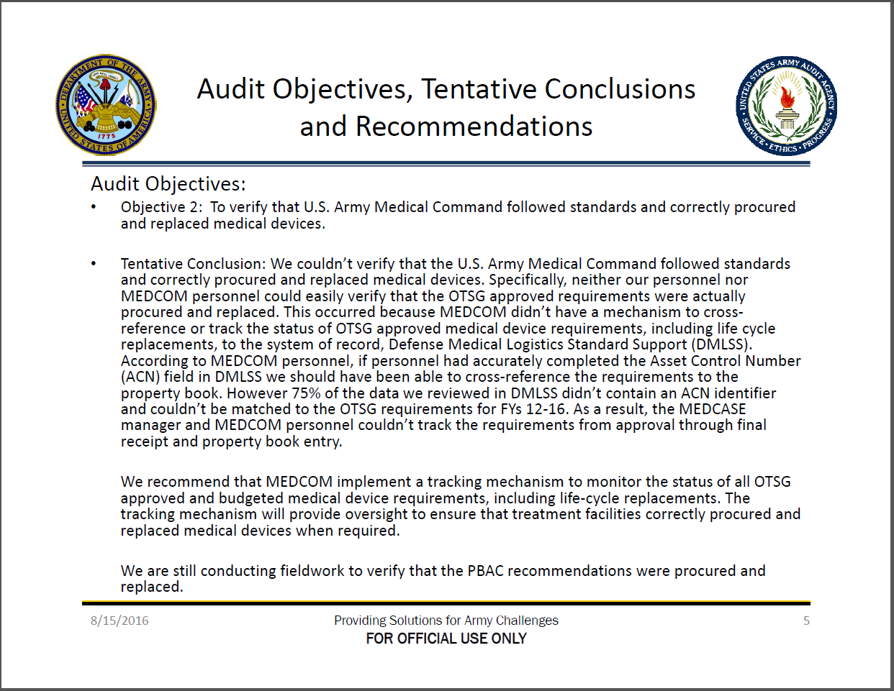
TAP Process Improvement
Notes:
USAAA A-2016-MTM-0169.000 (Audit of Medical Device Life Cycle Replacement)

Slide 48
Program Point of Contact
Unclassified//FOUO
Daniel V. Burrhus
Technology Acquisition Program
OACSLOG MEDCOM
G4/TAP
(210) 808-2826
DSN 471-2826
daniel.v.burrhus.civ@mail.mil
Unclassified//FOUO

Slide 49


Questions

